Slide 1
Geography

Slide 2
Vocabulary pg 3
Copy the following definitions:
Geography- the study of the Earth, people, places and environments.
Map Legend- gives symbols to represent places on a map
Map Scale- compares distance on a map to actual distance on the Earth.
Political Map- a map that shows human-made features and boundaries such as cities, highways and countries.
Physical Map- a map that shows naturally occurring physical features of the Earth.
Continent- one of seven major land masses of the Earth’s surface.
Absolute location- description of a place using grid coordinates (latitude and longitude)
Relative location- description of a place using the relation of one place to another
Compass rose-a directional arrow that shows cardinal and sometimes intermediate directions on a map
Immigrant- a person who leaves one area to settle in another
Migrate- to move from one geographic region to another
Pull factor- a reason that would attract someone to move to another place
Push factor- a reason that would make someone want to leave their place and go somewhere else

Slide 3
Geography

Slide 4
Globes and Maps

Slide 5
Globes
Globes are three dimensional representations of the earth

Slide 6
Advantages of Globes
Globes are more accurate than maps, better representation of the Earth.
Globes are not distorted

Slide 7
Disadvantages of Globes
Globes are not portable
Globes do not show detail
Globes are more expensive than maps
There are no thematic globes

Slide 8
Maps
Maps are two dimensional representations of the earth

Slide 9
Advantages of Maps
Maps are cheaper than globes
Maps show detail
Maps can show themes (thematic maps) and be used for comparing things
Maps can be put into a book called an atlas
Maps are portable

Slide 10
Disadvantages of Maps
Maps are distorted because the earth is not flat
Maps can distort shape, area, direction, and distance
This problem is somewhat solved by different map projections

Slide 11
Map Projections
Map projections are a way to draw maps in order to lessen distortion. There are different types of projections because people use maps for different reasons.

Slide 12
Different Types of Maps
Political Maps
Physical Maps
Topographic Maps
Thematic Maps
Cartograms

Slide 13
Political Maps
Political maps show man-made features such as cities, states, provinces, territories, or countries

Slide 14
Physical Maps
Physical maps help you see the type of landforms and bodies of water in a specific area

Slide 15
Maps vs. Globes Assignment
Write a short (2-3 paragraphs) comparing and contrasting maps and globes. Use your notes from yesterday to help you.
Remember: This is not Instagram or tumblr, use proper English and grammar.
Item #6

Slide 16
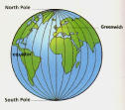





Map Skills
How do we find places on maps?

Slide 17
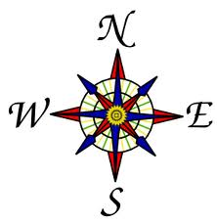
Vocabulary Term
Compass
Is a tool that helps the user know what direction they are going.

Slide 18

Directions on a Compass
Cardinal directions
Intermediate directions
North, South, East, West
Northeast, Southeast, Southwest, Northwest

Slide 19
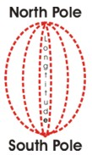
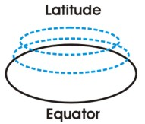
Imaginary Lines
Latitude and Longitude
The earth is divided into lots of lines called latitude and longitude

Slide 20
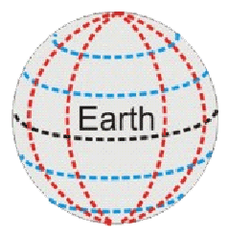
Lines
Longitude lines run north and south.
Latitude lines run east and west.
The lines measure distances in degrees.

Slide 21
Latitude
Lines run horizontally
Measures distance North or South from the Equator.
The Equator is 0 degrees Latitude.

Slide 22

Where is 0 degree?
Is 0 degree latitude.
imaginary belt that runs halfway point between the North Pole and the South Pole.
equator

Slide 23
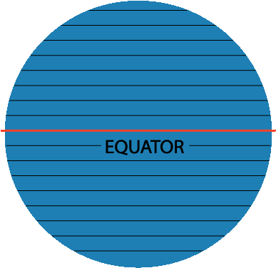
Latitude
North Pole
South Pole
90
80
Lines of North latitude are numbered from 0° to 90° are N.L.
[
70
60
50
40
30
20
Lines of South latitude are numbered from 0° -90° are S.L.
]
10
10
20
30
40
50
60
70
80
90
Notes:
TEKS: Social Studies –
6.22 (A), Using social studies terminology correctly
7.22 (A), 8.31 (A)

Slide 24
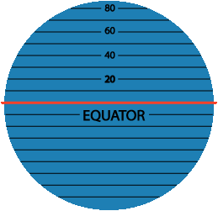
Latitude
The North Pole is at 90° N
The South Pole is at 90° S
The equator is at 0° latitude. It is neither north nor south. It is at the center between north and south.
40° N is the 40° line of latitude north of the equator.
40° S is the 40° line of latitude south of the equator.
Notes:
TEKS: Social Studies –
6.22 (A), Using social studies terminology correctly
7.22 (A), 8.31 (A)

Slide 25
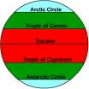
Major lines of latitude
North Pole
Arctic Circle
Tropic of Cancer
Equator
Tropic of Capricorn
Antarctic Circle
South Pole

Slide 26

Longitude
Lines of Longitude run vertically.
They are also called Meridians locate places East or West of the Prime Meridian.
There are 180 degrees of east Longitude, and 180 degrees of west Longitude.
The Prime Meridian is found in Greenwich, England and is 0 degrees Longitude.

Slide 27
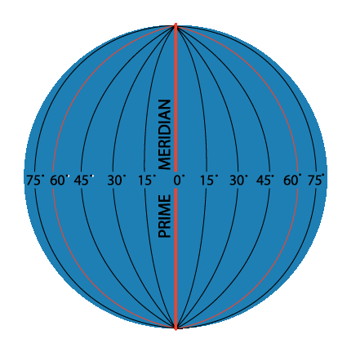
Longitude
Lines run vertically
Longitude lines are called Meridians
The main Meridian is called the PRIME MERIDIAN

Slide 28
Longitude
Lines of longitude begin at the Prime Meridian.
60° E is the 60° line of longitude east of the Prime Meridian.
60° W is the
60° line of
longitude west
of the Prime
Meridian.
The Prime Meridian is located at 0°. It is neither east or west
W
E
Notes:
TEKS: Social Studies –
6.22 (A), Using social studies terminology correctly
7.22 (A), 8.31 (A)

Slide 29
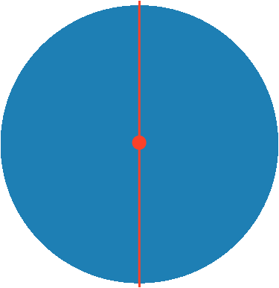
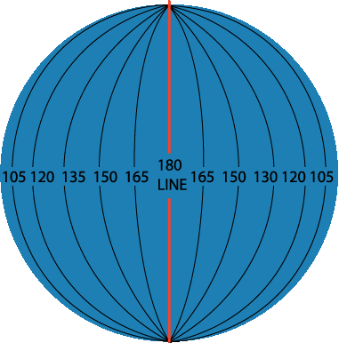
Longitude
180°
N
North Pole
W
E
West Longitude
East Longitude
PRIME MERIDIAN
S
Lines of longitude are numbered east from the Prime Meridian to the 180° line and west from the Prime Meridian to the 180° line.
Notes:
TEKS: Social Studies –
6.22 (A), Using social studies terminology correctly
7.22 (A), 8.31 (A)

Slide 30
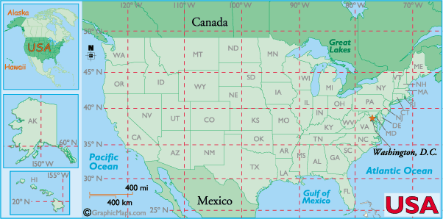

Slide 31
Longitude and latitude rap grid coordinates

Slide 32
Hemispheres
The Equator splits the earth into the northern and southern hemisphere
The Prime Meridian splits the earth into Eastern and Western hemisphere

Slide 33
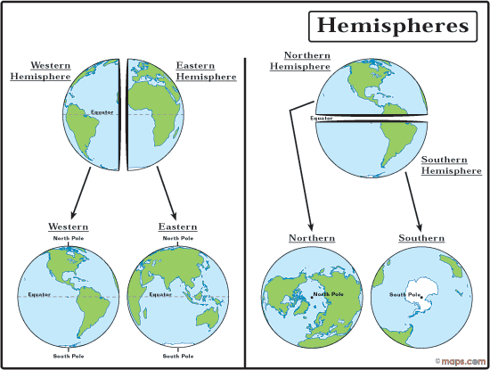

Slide 34
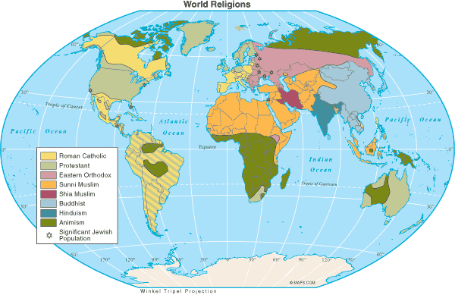
Map Legends/Key
Objects or colors in the legend represent something on the map.
Religions Legend

Slide 35
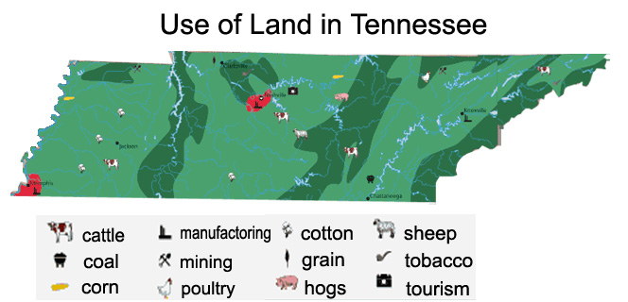
Can you understand this legend?

Slide 36
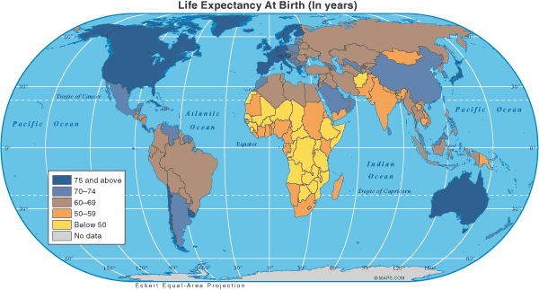
Age Expectancy
Legend

Slide 37
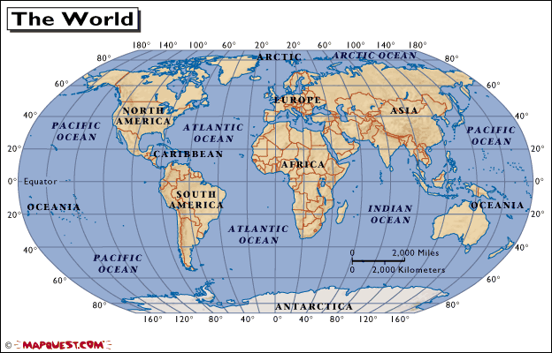
“How To” Foldable
Step #1:
Highlight the Equator YELLOW and Prime Meridian PINK
Step #2: Draw the Compass Rose in the bottom corner
* North, South, East, West, Northeast, Southeast, Northwest, Southwest
Step #3: Using the lines made by the highlighted equator and Prime Meridian to label the cardinal directions on the globe.
Step #4: Label the Hemispheres using the intermediate directions on the inside of the quadrant in the globe.
N
NW
NE
W
E
SW
SE
S

Slide 39
GLOBE SAYS
  This game follows the same rules as “Simon Says”
  Body parts represent the major lines of latitude
    Top of head – North Pole
    Ears – Arctic Circle
    Shoulders – Tropic of Cancer
    Waist – Equator
    Knees – Tropic of Capricorn
    Shins – Antarctic Circle
    Toes – South Pole

Slide 40
Longitude and Latitude Practice
Use pp. A16 and A17 in your green textbook. Copy each coordinate and then find it on the map/atlas. Find the city or island located at each of the following coordinates; write the name of the city or island on the first line. Also, tell the hemisphere of each location; write the hemisphere on the second line.
1. 39°S, 140°E ______________________________, _______________
2. 33°N, 120°W _____________________________, _______________
3. 20°N, 73°E _______________________________, _______________
4. 57°N,41°E________________________________, _______________
5. 15°S, 48°E________________________________, _______________
6. 38°N, 140°E_______________________________, _______________
7. 14°N, 100°E_______________________________, _______________
8. 18°N, 101°W______________________________, _______________
9. 0°longitude, 50°N__________________________, _______________
10.21°S, 44°W________________________________, _______________

Slide 41
Map skills review packet
Complete the packet for map skills. This will be homework if not completed and we will grade on Thursday

Slide 42
Continents?
What are the seven continents? Five oceans?
Why do we need to know the seven continents?
Tour the World
Learn the Seven Continents

Slide 43


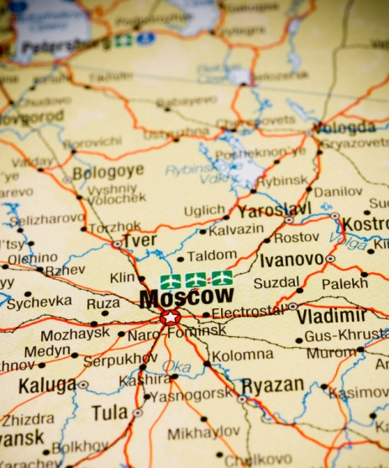

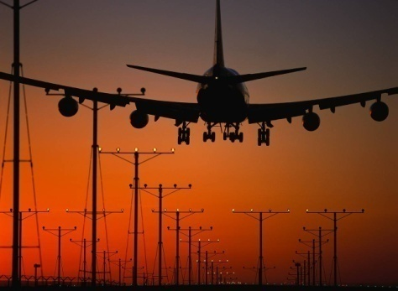
THE 5 THEMES OF GEOGRAPHY
CH 1 SECTION 1 NOTES

Slide 44
Five Themes of Geography
Theme and description | Examples and Key words
Movement -
Regions -
Human-Environment Interactions -
Location -
Place -

Slide 45
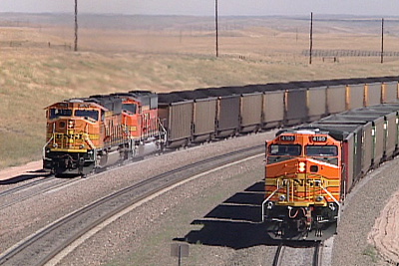
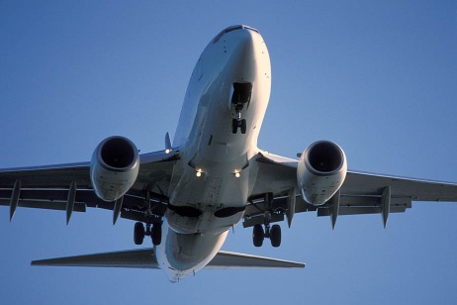


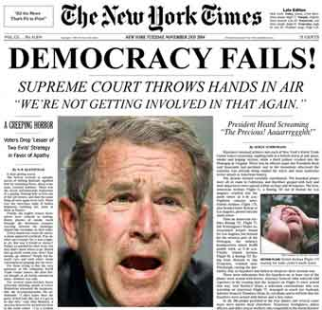
MOVEMENT
How are people, goods, ideas moved from place to place?
  Human Movement
    Trucks, Trains, Planes
  Information Movement
    Phones, computer (email), mail
  Idea Movement
    How do fads move from place to place?
    TV, Radio, Magazines

Slide 46
REGIONS
How are Regions similar to and different from other places? How places are grouped?
  Formal Regions
    Regions defined by governmental or administrative boundaries (States, Countries, Cities)
    Regions defined by similar characteristics (Corn Belt, Rocky Mountain region, Chinatown).
  Functional Regions
    Regions defined by a function (newspaper service area, cell phone coverage area).
  Vernacular Regions (Not in your book)
    Regions defined by peoples perception (middle east, the south, etc.)

Slide 47
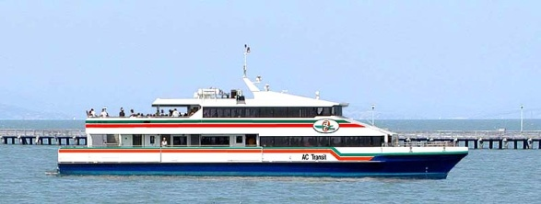

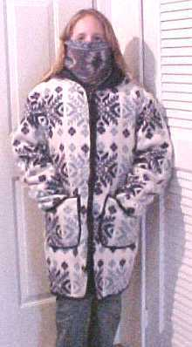
HUMAN-ENVIRONMENT INTERACTION
How do humans and the environment affect each other?
  We depend on it.
    People depend on the Tennessee River for water and transportation.
  We modify it.
    People modify our environment by
    heating and cooling buildings for comfort.
  We adapt to it.
    We adapt to the environment by wearing
    clothing suitable for summer (shorts) and
    winter (coats), rain and shine.

Slide 48
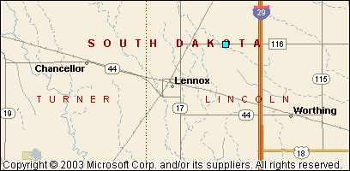
LOCATION
Where are we?
Absolute Location
  A latitude and longitude (global location) or a street address (local location).
      Paris France is 48º North Latitude and 2º East Longitude.
      The White House is located at 1600 Pennsylvania Ave.
Relative Location
  Described by landmarks, time, direction or distance. From one place to another.
      Go 1 mile west on main street and turn left for 1 block.
You are Here

Slide 49
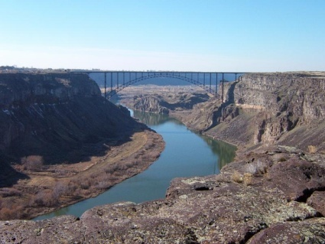

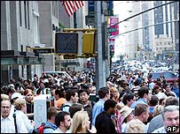

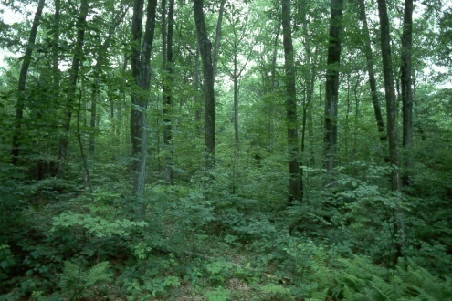
PLACE
What is it like there, what kind of place is it?
Human Characteristics
    What are the main languages, customs, and beliefs.
    How many people live, work, and visit a place (population).
Physical Characteristics
    Landforms (mountains, rivers, etc.), climate, vegetation, wildlife, soil, etc.

Slide 50
Remembering the 5 themes
If you can’t remember what they are just ask MR. HELP!!!
    M – Movement
    R – Regions
    HE – Human Environment interaction
    L – Location
    P - Place

Slide 51
http://youtu.be/AIqC79WrpKg

Slide 52
Your assignment
Complete your “5 Theme Notes” with key words, symbols, etc on right hand side of the notes. Use color, simple words, clipart, magazines, etc.
Be sure to have #3 vocab completed in notes by tomorrow. (you may need them! Hint, hint!)
I will check this tomorrow during warm-up.

Slide 53
https://app.discoveryeducation.com/player/view/assetGuid/52E7BB9F-807C-484E-9A55-50AD881AA524

Slide 54
Postcard- Five Themes of Geography
You will use all that you know about the 5 themes of geography to create a postcard from any place you’d like to go.
Requirements:
1. You must use ALL five themes on the notecard.
2. The picture side (the blank side of one notecard) must
- be fully colored
- include pictures and/or drawings relating the 5 themes to your destination (1 per theme is good.)
- have a slogan (catchy phrase or the location’s name)
3. The written side (other side of notecard) must explain in detail how each of your symbols represent/show the five themes. Grammar and spelling count. You can write this in paragraph form or in list form with explanation.
4. Make it beautiful, colorful, you can type it if you’d like. This is due tomorrow!

Slide 55
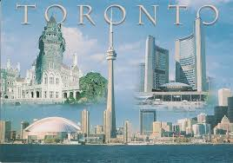
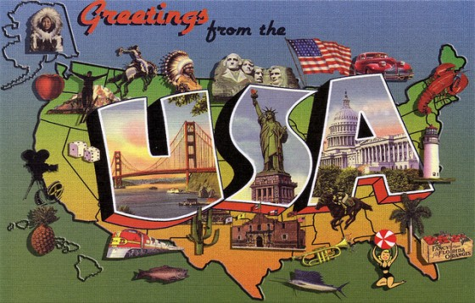

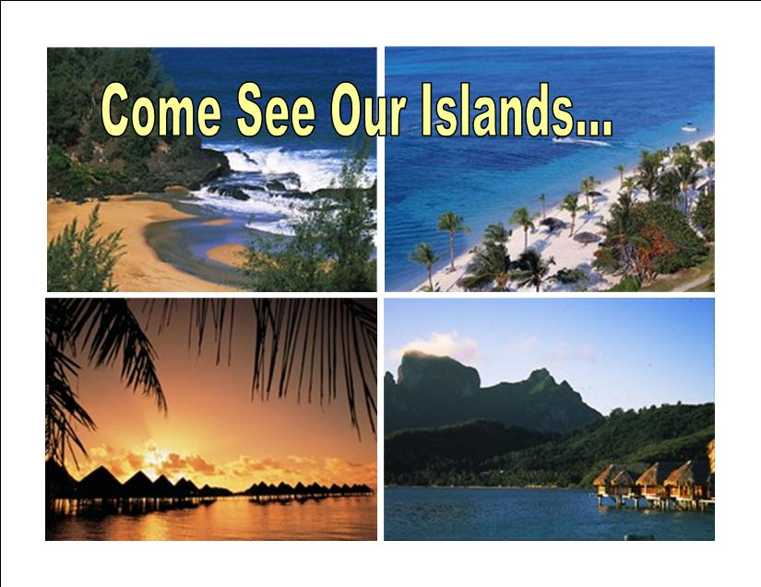
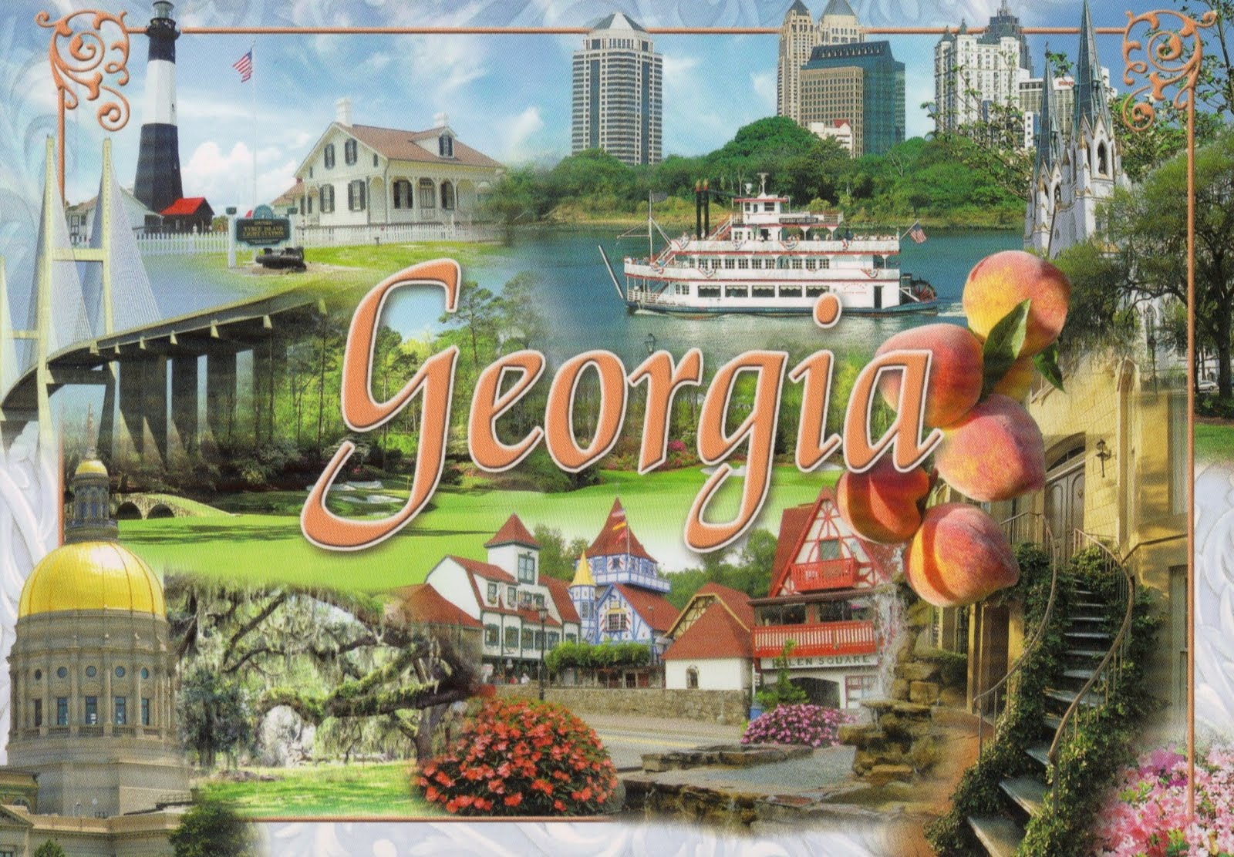

Slide 56
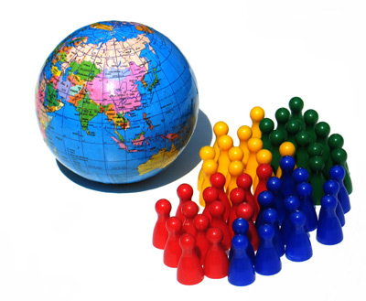
WHAT IS POPULATION?

Slide 57

What is population?
Geographers use the term population to mean the total number of people who live in a specific area.
The population of the world today is more than 7 billion people.
Question: What factors might have contributed to our increasing population over time?

Slide 58
Population Distribution and Density
Today, the largest populations are found in what are called habitable lands.
Habitable lands are lands that are suitable for human living.
Video
Only a small portion of the Earth’s surface is suitable for humans to settle.
Almost 75% of the Earths surface is water.
In addition, between 35 and 40 % of the Earth’s land is too hot, too cold, too wet or too dry to live on.

Slide 59
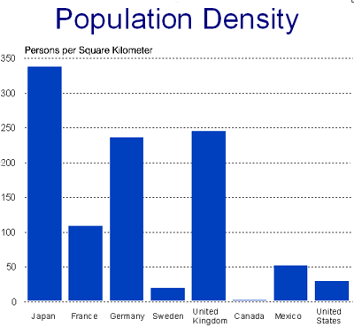
Population Density
Population Density shows on average how many people are living in a specific size area such as a square mile or square kilometer.
To find the population density of a location, add up the total number of people living in an area and divide by the total amount of land they occupy.
Demographers are geographers who study the characteristics of human population.

Slide 60
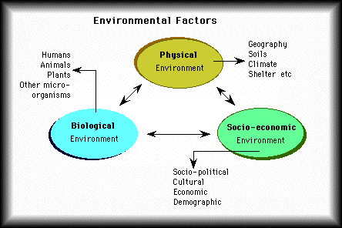
What factors influence population distribution?
Environmental factors—
  What type of natural resources are in the area? Does it have oil, or fertile land or access to water?
  What is the climate like?
  Does it have resources such as transportation and technology?

Slide 61
Economic factors--
  What type of economy does it have?
  Is the economy strong and making money?
Political factors--
  What is the government policy?
  Are there many conflicts?
  Is it a rural/urban area?

Slide 62
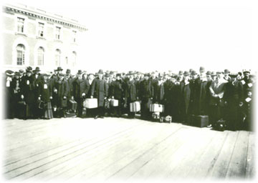
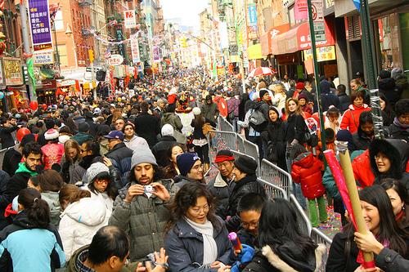
The Geography of Population
Question: What are some challenges that could result from rapid growth?
              Ellis Island New York City

Slide 63
Growth Challenges
The expanding population creates serious challenges.
What do YOU think are some challenges to the increasing population?
-In some countries, it is difficult to provide the basic needs of food, clean water and housing.
Many people move to the cities to try to make a better life for themselves, but there are not enough materials to build proper shelter or sewers.

Slide 64
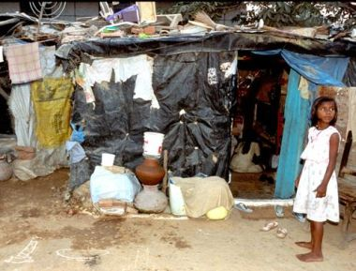
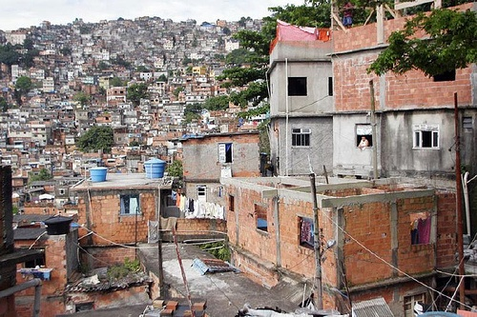
Effects of Overcrowding
Overcrowding: Japan
Shanty houses on the outskirts of a city.
Overcrowding: Nigeria

Slide 65
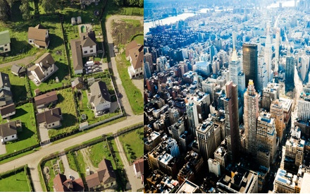
Podcast
Question: What are factors that influence where people choose to live?
Rural vs. Urban
Rural areas are areas that relate to the country or farms.
Urban areas refer to cities.

Slide 66
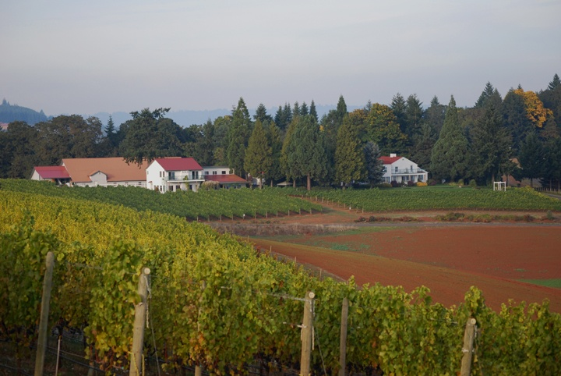
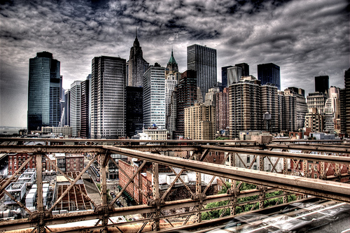
Choose: Rural or Urban?
Rural or Urban?
Question: Which setting would you prefer to live in? Why?
Rural or Urban?

Slide 67
7 Billion and Counting Video
https://www.youtube.com/watch?v=sc4HxPxNrZ0
See next slides for propaganda…

Slide 68
Strongly Agree
Agree
Strongly Disagree
Disagree

Slide 69
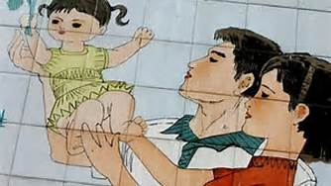
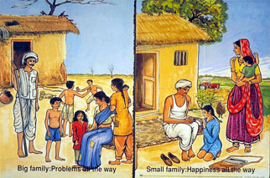

Slide 70
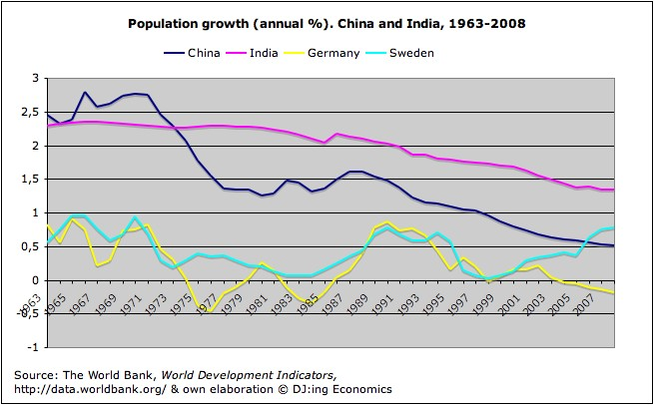

Slide 71
Group Share
After considering all of the statements from the four corners activity, what do you think are the biggest issues/problems associated with population?

Slide 72
Group Share
What do you think should be done to solve these problems?
Who should be responsible?

Slide 73
Push/ Pull Factors
Push factor- reasons that cause people to leave an area.
Pull factor- reasons that attract people to another area
Migration- moving from one place to another
Refugee- a person that flees a place for safety reasons

Slide 74
Push/ Pull Factors
Push | Pull
Diseases in the area | Job opportunities
War | Carowinds- amusemen parks
Dislike (prejudice or persecution) | Good government
Lack of resources | Freedom
Bad government or failing government | Safe neighborhood

Slide 75
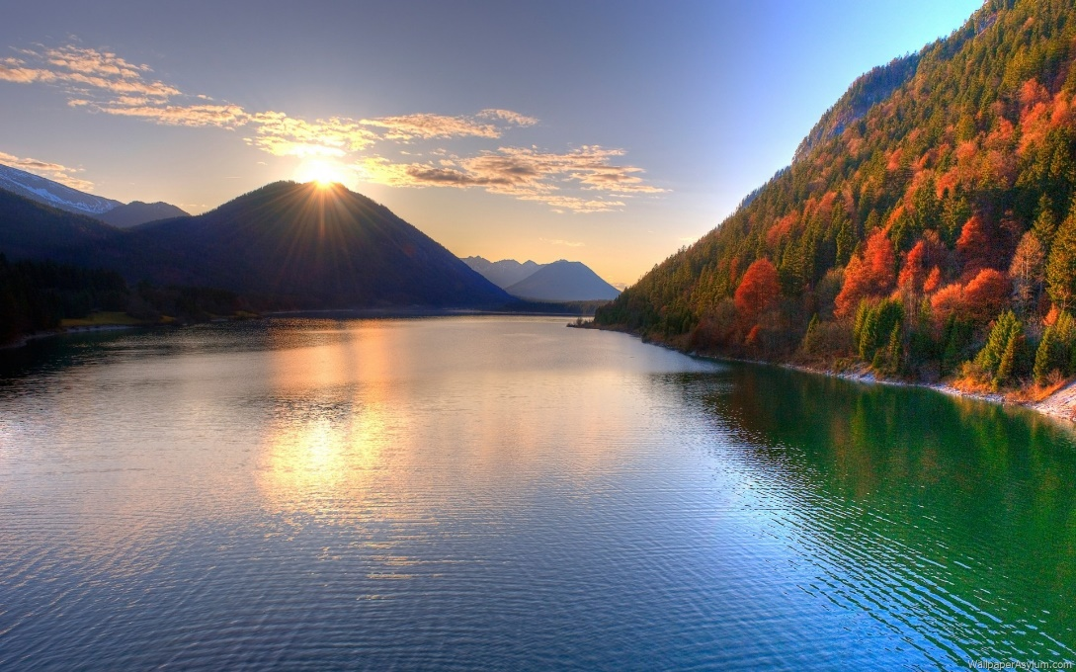
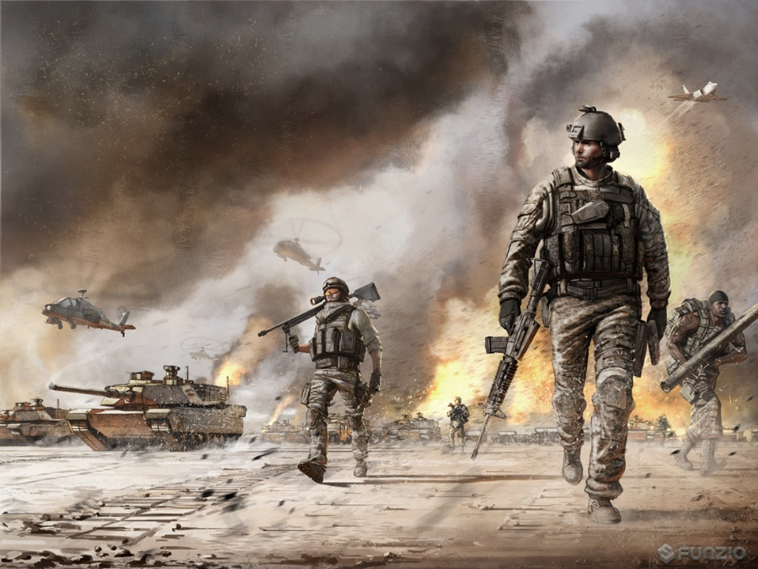
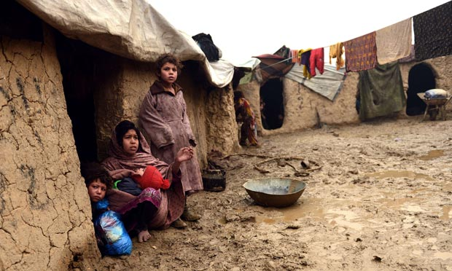

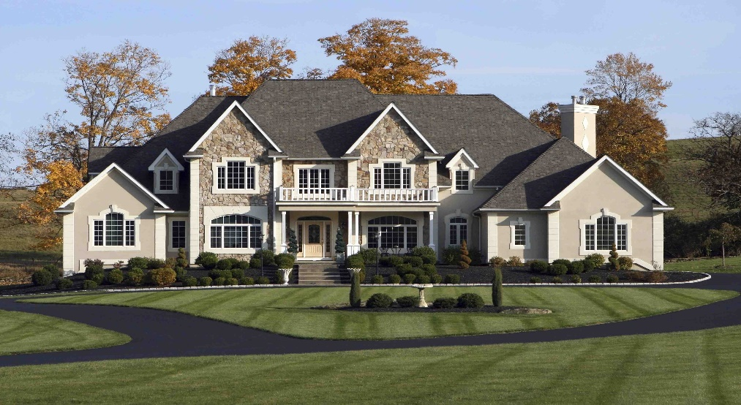

Slide 76
Kahoot!
https://play.kahoot.it/#/?quizId=af25de90-6c68-4e25-8754-88753d708377

