Slide 1
Ancient Rome’s Geography
Unit 13
Red= Left, Blue = Right

Slide 2
Advantages
Predict advantages if Rome’s location:
Rome’s location offered several advantages.
Your Group’s answer
The Italian peninsula offered protection by the hills and mountains found throughout the area

Slide 3
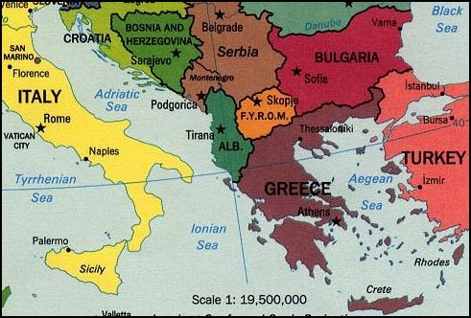

Slide 4
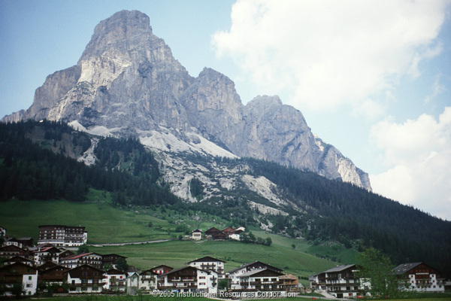
Two Mountain Ranges
Two major mountain ranges
The Alps Mountains, Europe’s highest mountains, separated the Italian peninsula from the rest of the continent.
The Apennine Mountains run north to south along the length of the Italian peninsula

Slide 5
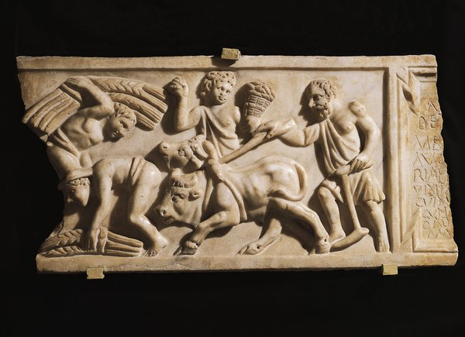
Climate
How did the Climate help Romans?
The region had mild, rainy winters and hot, dry summers.
Made it possible for the region to develop a strong agricultural base.
Grew wheat, grapes, and olives and build a consistent food supply.

Slide 6
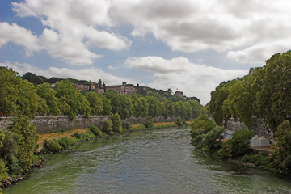
Tiber River
Agriculture
The growing agricultural system was aided by the nearby Tiber River.
The Tiber provided a reliable source of fresh water used for irrigating their farms
As well as drinking water for humans and animals. However, unlike many other civilizations, Rome did not develop in the river’s delta.

Slide 7
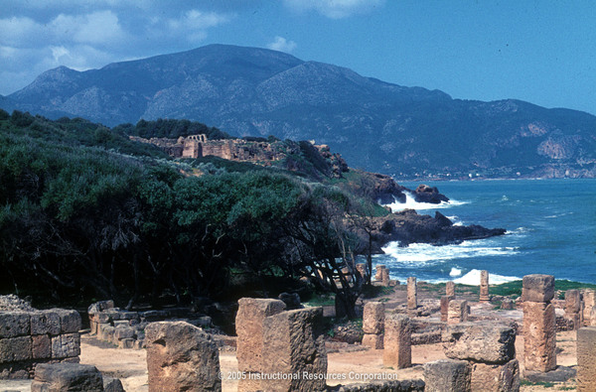
Mediterranean Sea
How was the Mediterranean Sea important to Rome?
trade was an important part of life in ancient Rome.
Rome developed several trade routes throughout the Mediterranean Sea and established trade with other civilizations.
Later, the Roman armies used these same routes to conquer large amounts of territory and expand the empire along the Mediterranean.

