Slide 1
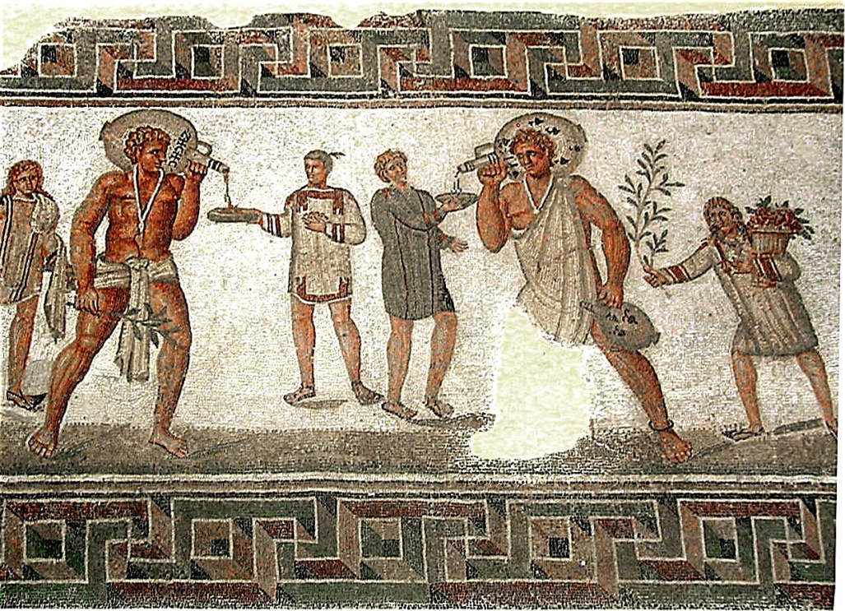
The Roman Republic

Slide 2
The Founding of Rome
Romulus and Remus:. Video
Think about these questions as you watch the video
Who is the father of Romulus and Remus?
What river were the babies sent to float down?
Who watched over Romulus and Remus?
Where did Romulus want to build his city?
Why did Romulus kill Remus?

Slide 3
People involved in the Republic Government
Plebeians:
Patricians:
Magistrates:
Consuls:
the group of common people or peasants in Rome who were calling for changing the government where they had more of a say in how the city was run.
Roman nobles who ran the government. Only they could be elected to office, so they held all political power.
Elected government officials.
The title of the two most powerful magistrates.

Slide 4
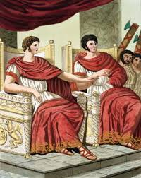
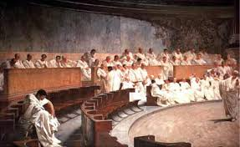
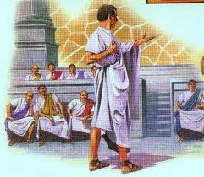
Parts of the Roman Republic
Made up of three parts
1. Magistrates
2. Senate
3. Assembly

Slide 5
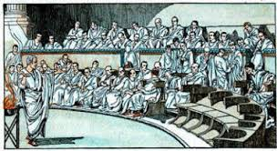
Part 1: Magistrates
Who are Magistrates?
What was their role?
were 20 elected officials who ruled for one year.
The magistrates performed many duties, acting as judges, tax collectors, and urban planners

Slide 6
Part 1: Magistrates
Who are Consuls?
What was their role?
How long did they serve?
The two highest magistrates were called Consuls. Was the most powerful political position in Rome.
The consuls issued laws and led the army. In order to prevent one person from becoming too powerful, each consul could veto the decisions of the other.
Additionally, consuls, like the other magistrates, only served for one year.

Slide 7
Part 2: Roman Senate
Who made up the Roman Senate?
How long did you serve?
What was their role?
was made up of 300 men, who at first were only selected from the patrician class
Senators were elected and held their offices for life
First the Senate’s only job was to advise the consuls, but over time, it gained power.
eventually becoming the most important part of the government and making decisions about laws, foreign policy, and finance.

Slide 8
Part 3: Roman Assembly
What did the Assembly do?
Who was apart of the Assembly?
What power did the Assembly have ?
Protected the rights of the plebeians. The plebeians had an assembly, or lawmaking body, of their own called the Council of the Plebs.
This assembly could elect ten officials, called tribunes, or tribunes of the plebs.
The tribunes had the power to veto the actions of the consuls or the Senate.
The veto power meant that this group of tribunes had the ability to limit what the Senate and the consuls could do, which made them very powerful.

Slide 9
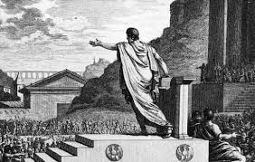
Representative Government
What is a representative government?
leaders are elected by the people to serve in government and represent the views of the entire society.
Rome, unlike in Athens, not everyone’s views were represented. However, the idea of elected officials serving the interests of the entire society was an important innovation in political thought.

Slide 10
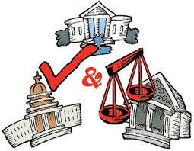
Separation of power
What does this mean?
Modern Day Example
no one person, group, or branch of government has all the power.
This idea was central to the creation of the United States government.
The United States government is separated into three branches—the legislative, executive, and judicial branches—each with their own powers and responsibilities.

