Slide 1
China Vocabulary
Define the following words:
Region-a part or section of a country
Climate - the average weather conditions at a particular place
Oasis - a place, usually in a desert, where water can be found
Silk Road- a network of trade routes that stretched for more than four thousand miles across Asia
Trade Route- a network of roads along which traders traveled
Caravan- a group of people traveling together
Great Wall- a stone-and-earth wall about 1,500 miles long, first built during the Qin dynasty to defend China’s northern boundary
Cultural Diffusion- the spreading of cultural traits, such as goods and ideas, from one culture to another, or within one culture

Slide 2
Geography of China

Slide 3
Where is China located?
Ancient China was located in the eastern portion of Asia.
Today, China covers much of the continent of Asia.
It stretches more than 3,000 miles from east to west and another 3,000 miles from north to south.
It is the third largest country in the world by area and it has the world’s largest population.
China has almost 9,000 miles of coastline and touches the Yellow Sea, the East China Sea, and the South China Sea.
China shares borders with 14 countries.
As in Mesopotamia, Egypt, and the Indus River Valley, the earliest civilizations in China emerged along rivers.
Rivers in China:
The Chang Jiang (Chang Jyahng) or Yangtze (Yahng say)
Huang He (hwang huh)

Slide 4
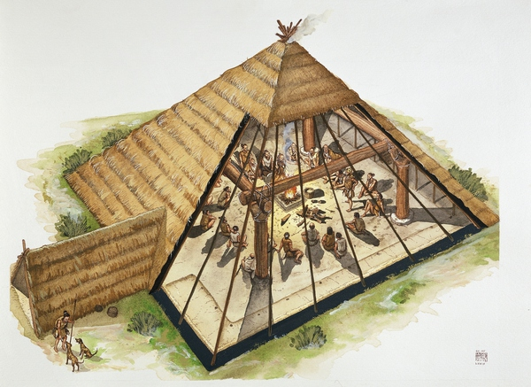
Banpo Civilization
Banpo Civlization-
Developed along the Huang He river
Domesticated pigs and dogs
Made pottery and put markings to identify what they kept in the containers.
Home were built on top of older homes
Large ditch around the community to keep wild animals out
When infants and children died, they placed bodies in pottery jars and buried them.
Adults were buried in a cemeteryThe Shang Dynasty

Slide 5
Shang Dynasty
Emerged along the Huang He River
Built their own empire and conquered others
First Chinese dynasty for which there are both written records
Developed musical instruments, artwork, calendar, and Chinese writing
Used symbols called pictographs and wrote on bones and shells
Oracle Bones
Oracle bones were used to write questions on. They might ask questions to their dead ancestors or deities about crops, hunting, warfare. The bones and shells were burned and someone would interpret the cracks in the bones to find answers to the questions.

Slide 6
China’s Ancient Cities
Chinese history is divided into dynasties which is a line of hereditary rulers from the same family ruling over the same country
Qin Dynasty
In 350 BCE, Xianyang (shee ahn yahng) became the capital of China.
Xianyang was a big trading city and is now known as the city where the terra-cotta soldiers and horses are buried to protect Qin emperor
Han Dynasty
Chang’an was the new capital as capitals usually moved with the emperor.
During this dynasty the Silk Road was created.
Powerful commerce and trading city

Slide 7
China’s Great Deserts
Largest deserts in the world: Gobi Desert and the Takla Makan Desert
Gobi Desert
Northern part of China
Some of it is sand but most is bare rock
Getting through the desert is very difficult so most people avoided traveling through it
Most who did travel were traders and traveled by camel in caravans
Takla Makan Desert
Western part of China
It has a milder climate than the Gobi and some water sources and vegetation
Limited travel because of the size and large sand dunes
These deserts gave China protection from invaders since they had to use horses to invade not camels which were the only animals that could travel
The deserts also limited China’s expansion to other civilizations

Slide 8
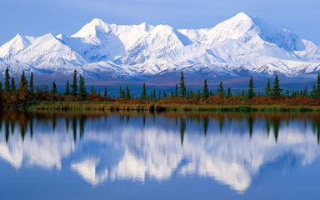
Himalayas
China has many mountain ranges that traders and travelers were able to learn how to cross to expand or explore.
The Himalayans were very difficult to cross and this caused problems for expansions.
The Himalayans have the highest mountain, Mount Everest with an elevation of around 29,000 feet (1 mile- 5,280 feet)
Himalayans are the border between China and India
While this prevented the Chinese from expanding into India, it also prevented India from expanding into China.

Slide 9
The North of the Wall
To the north of China is Mongolia.
The Mongols were excellent horsemen who could also fight on horseback which gave them a great advantage over the Chinese.
Since the Chinese were not as advanced, they had to work on their defense.
The Great Wall of China was not successful in keeping the nomads from invading
Multiple nomadic groups would invade and settle in parts of northern China.
In the early 1200s, China could no longer hold their land and the Mongols conquered all of China by their Genghis Khan.
Mongols created the largest land based empire in the world.

Slide 10
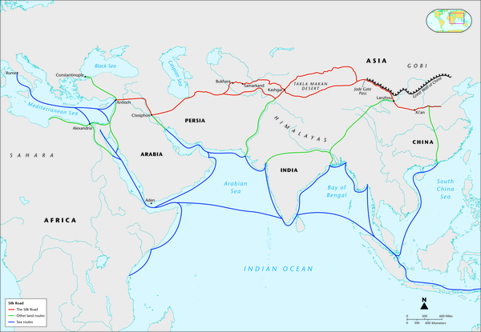
Trading in China
Trading was difficult because of mountains and deserts. Traveling around brought them closer to the nomadic tribes to the north. Caravans were often attacked and robbed.
Chinese traders turned to sea routes
Sea travel was also very dangerous so they did not travel long distances.
Limited where China could trade
Because trading was limited, cultural exchanges were also limited and they did not have many interactions with other cultures.

Slide 11
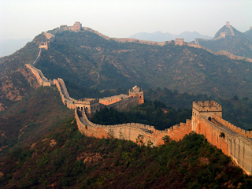
Overview
China’s geography impacted the civilization greatly.
Defense from foreign invaders
Struggle to expand its borders
Ability to trade and communicate

Slide 12
Image Cafe
Ancient China

Slide 13
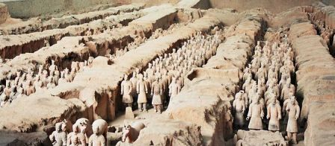

Slide 14
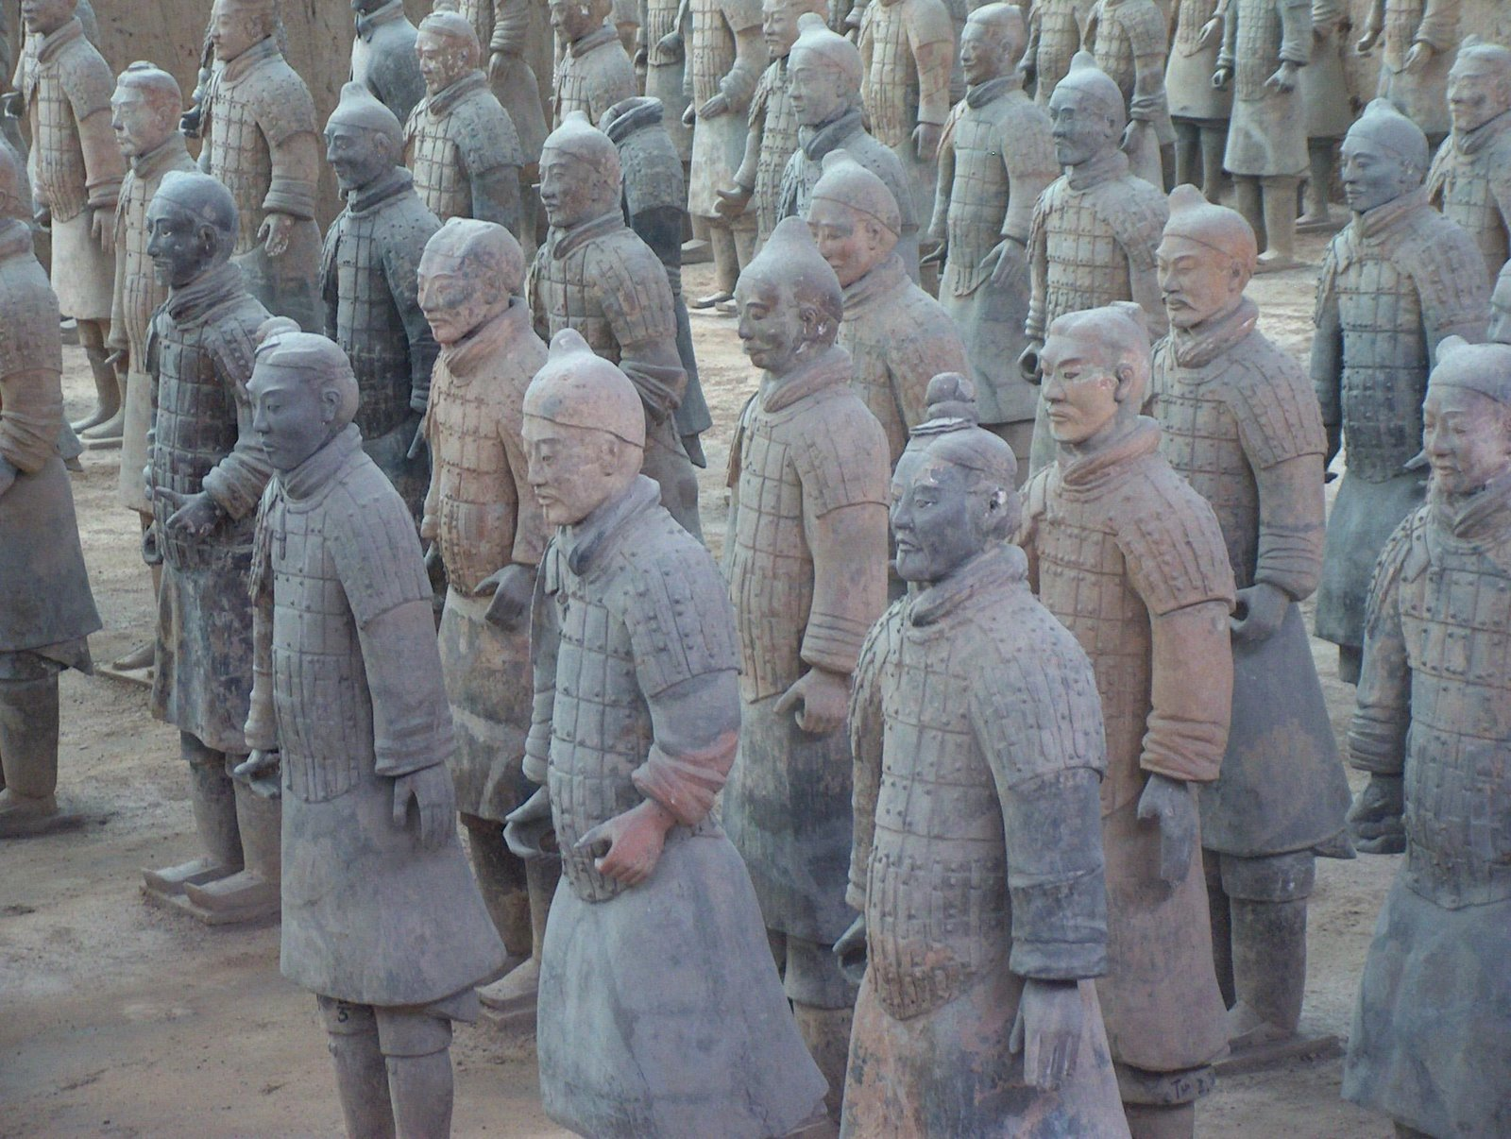

Slide 15
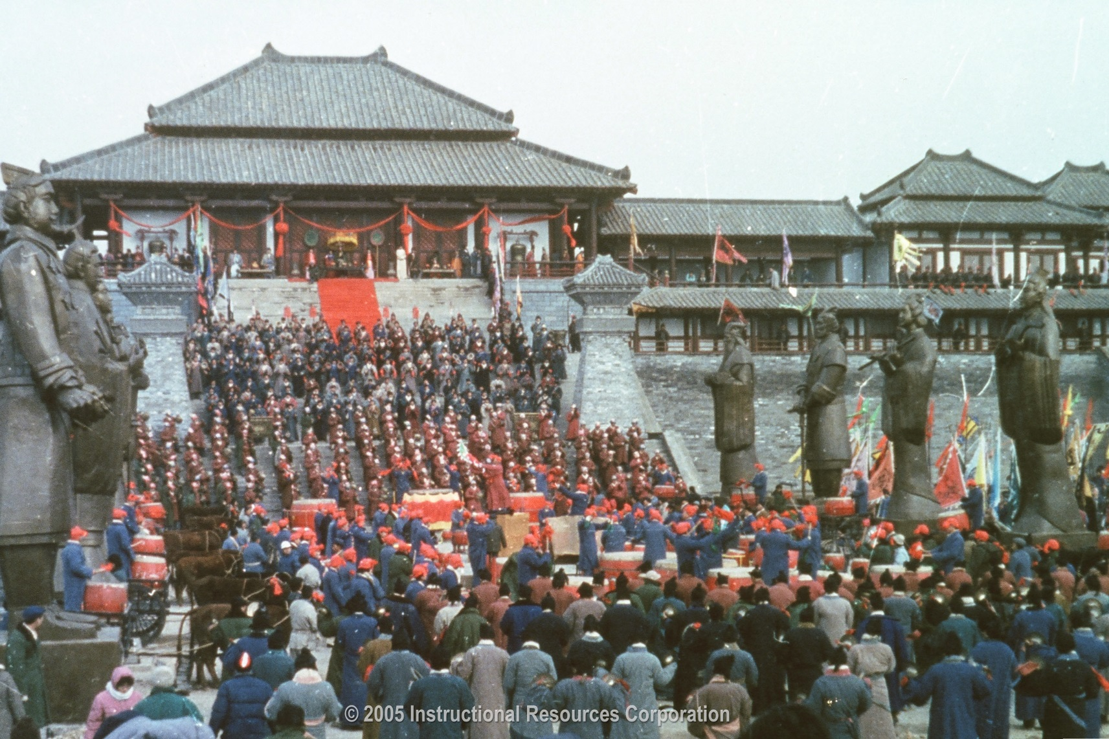

Slide 16
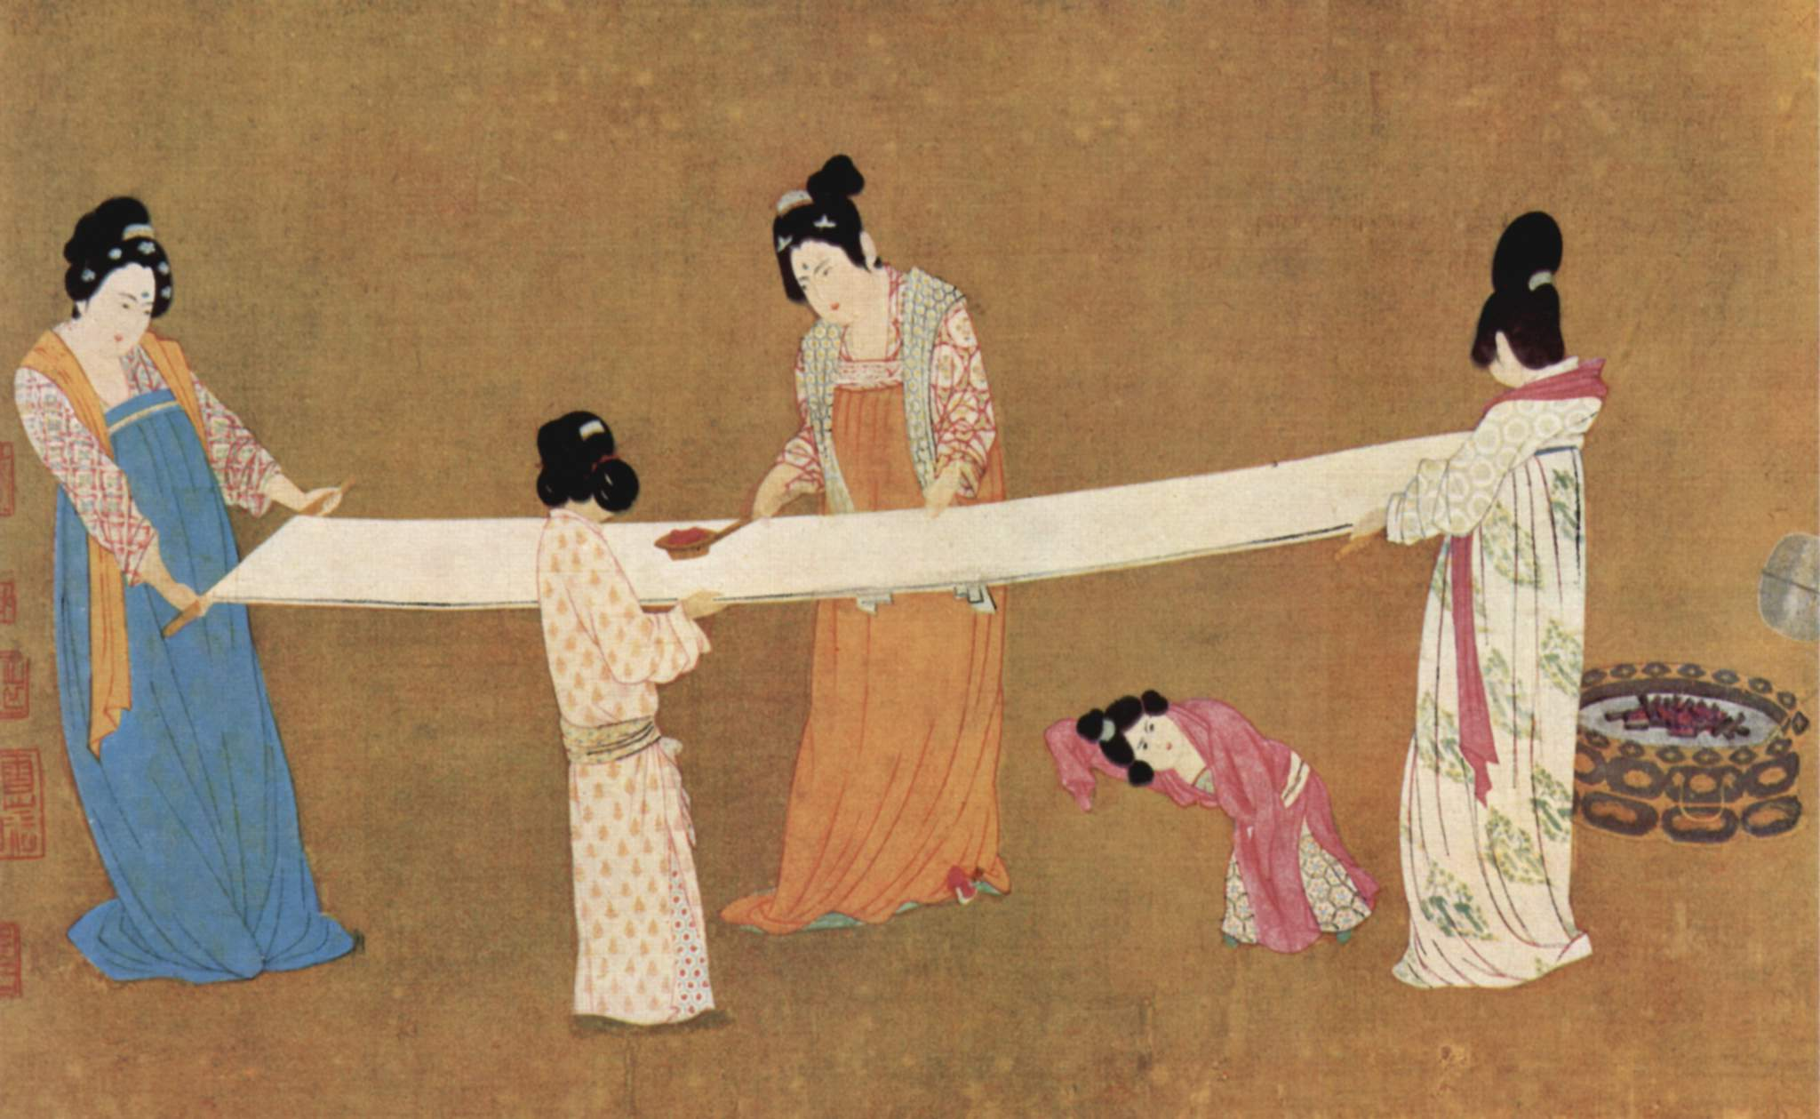

Slide 17
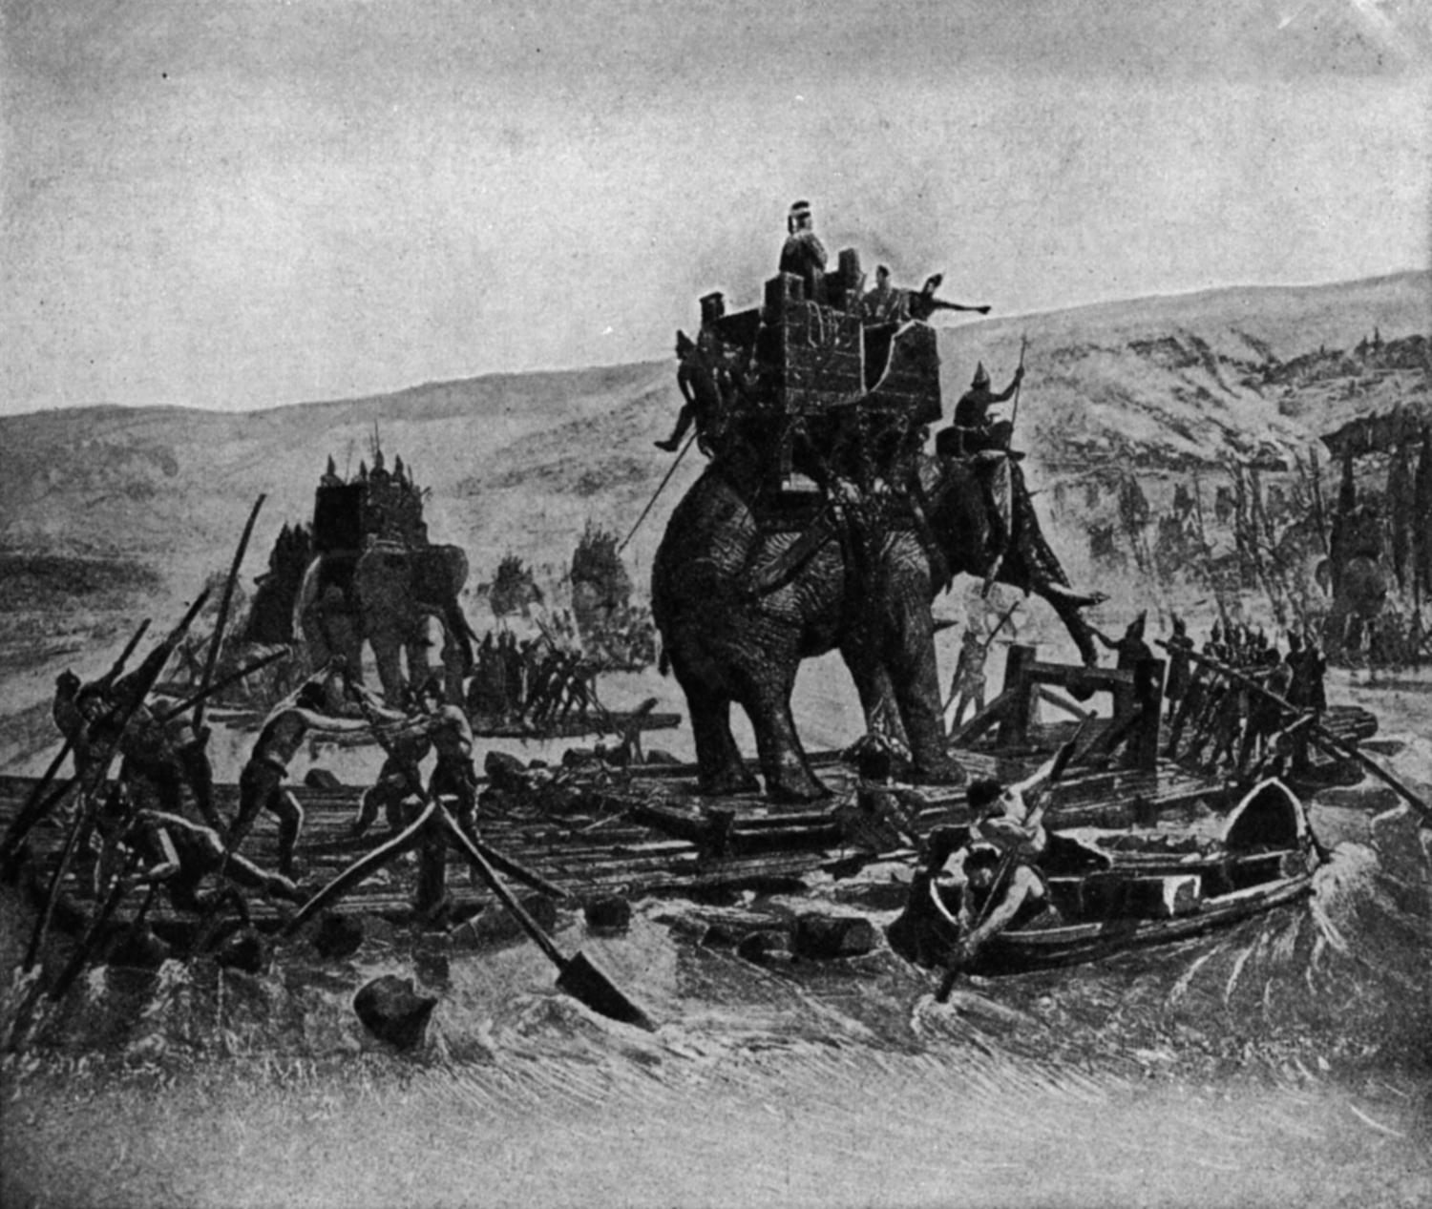

Slide 18
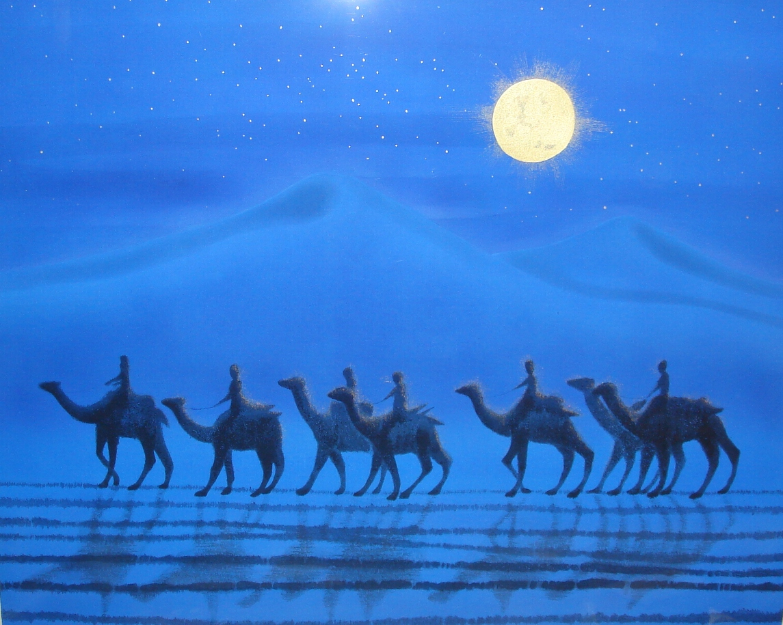

Slide 19
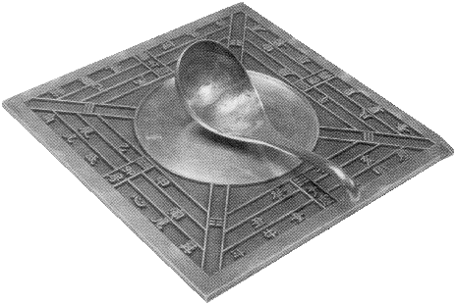

Slide 20
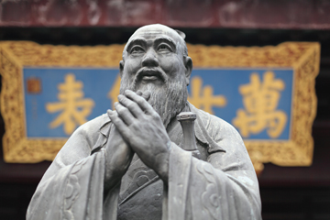

Slide 21
Great wall of china
Read the green passage in 7.3, page 5, at the bottom right. Answer the questions with the reading passage in notebook (item 11) in complete sentences.
When done, work with your group to create a pro/con list of building the Great Wall of China. Read the directions of the bottom of the page for your next assignment. Due TOMORROW!

Slide 22
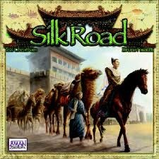
THE SILK ROAD: MOVEMENT OF GOODS AND IDEAS
THE “ANCIENT INTERNET” WHERE YOU COULD “MAKE A KILLING” OR BE KILLED

Slide 23
200 B.C.—1300’S A.D.
THERE WERE SEVERAL ROUTES THAT MADE UP SILK ROAD, BUT THEY ALL WENT FROM CHINA TO THE MIDEAST (& THEN INTO EUROPE)
ROUGHLY 4,000-5,000 MILES
NO MERCHANT TRAVELLED THE WHOLE ROUTE TO BUY AND SELL
EACH STAYED IN THEIR OWN REGION OR WENT SLIGHTLY BEYOND

Slide 24
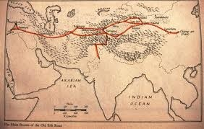
DIFFERENT LAND ROUTES
ALL ROUTES WERE DANGEROUS!!
DESERTS, MOUNTAINS, RIVERS, SNOW
BANDITS, CORRUPT OFFICIALS, WARS
WATER, FOOD, INJURIES, DEAD ANIMALS

Slide 25
WHY IT EXISTED
ROMANS 1ST SAW SILK DURING A BATTLE AND IMMEDIATELY WANTED IT
WHEN MERCHANTS REALIZED ROMANS WANTED IT AND WOULD PAY GOLD FOR SILK, TRADING ROAD BEGAN
CHINESE WERE ONLY ONES WHO KNEW THE SECRET OF MAKING SILK AND GUARDED IT FOR A 1,000 YEARS

Slide 26
MAKING OF SILK
http://www.youtube.com/watch?v=IFo3SxqH2-A&feature=player_embedded
THIS WAS A IMPERIAL SECRET KEPT BY CHINESE EMPERORS:
SILK PRODUCTION WAS A LIFE AND DEATH MATTER FOR CHINA
HISTORY SAYS MONKS SENT BY JUSTINIAN HID SILKWORMS IN CANES AND BROUGHT THEM BACK

Slide 27
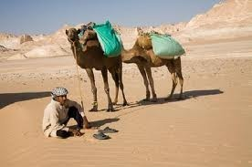
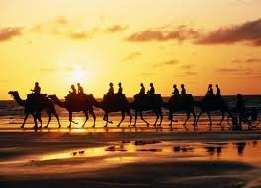
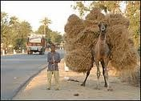
CAMELS, HORSES, YAKS
CAMELS PREFERRED IN DESERTS: CARRIED 400 POUNDS, BIG FEET DIDN’T SINK IN SAND, NEED LITTLE WATER, GO LONG DISTANCES

Slide 28
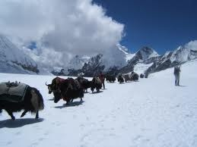
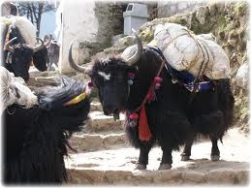
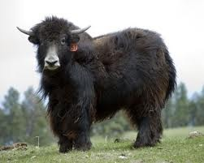
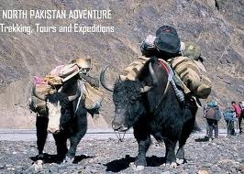
YAKS
GOOD IN MOUNTAINS, SLOPES, IN SNOW AND ICE

Slide 29
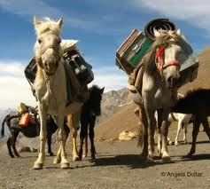
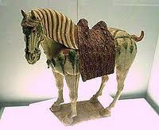
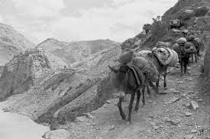
HORSES
GOOD ON VARIABLE TERRAIN, CARRY DECENT LOADS, GOOD SPEED, EASIER TO MANAGE

Slide 30
A LOOK AT THE SILK ROAD
http://www.youtube.com/watch?v=LowP8zYHDYA&feature=player_embedded
SAMARKAND:
http://www.youtube.com/watch?v=KpE1JJIavVk&feature=player_embedded
http://www.youtube.com/watch?v=KpE1JJIavVk&feature=player_embedded

Slide 31
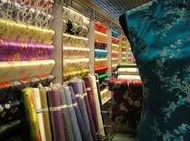
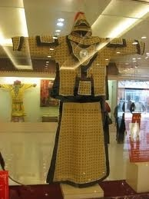
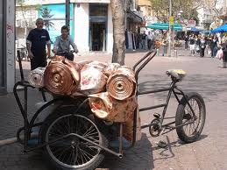
GOODS TRADED
SILK #1!

Slide 32
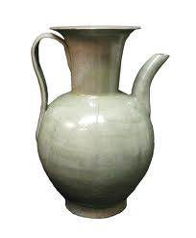
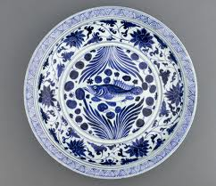
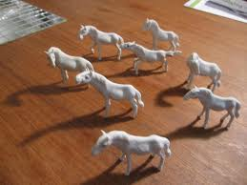
PORCELAIN
ONLY THE CHINESE COULD MAKE THIS FORM OF POTTERY:
NEED FELDSPAR AND 2,500°F TEMPS
BECAME SO FAMOUS WE STILL CALL DISHES AND CUPS “CHINA”

Slide 33
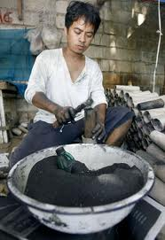
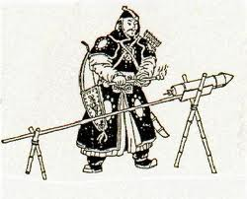
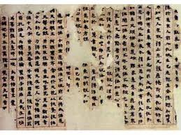
PAPER AND GUNPOWDER
CHINESE INVENTIONS!
PAPER ,AS WE KNOW IT, FROM HERE (EXISTED EARLIER IN OTHER FORMS)
EUROPE MAKES PAPER ~ 1,100 A.D. AND GUNPOWDER ~ 1,300 A.D.

Slide 34
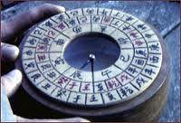
COMPASS
GAVE CARDINAL COORDINATES (N,E,S,W): INVALUABLE FOR SAILORS, MERCHANTS, ARMIES
W/ SEXTANT (ASTOLABE –from ARABS) COULD TELL HOW FAR NORTH/SOUTH OF EQUATOR

Slide 35
INDIA: SILK ROAD DESTINATION
GUPTAS ENCOURAGE TRADE AND A ROAD HEADS SOUTH INTO INDIA
COTTON
SPICES—LOTS AND LOTS
PRECIOUS GEMS & PEARLS
IVORY & ELEPHANTS
EXOTIC WOODS (TEAK, SANDALWOOD)
SLAVES

Slide 36
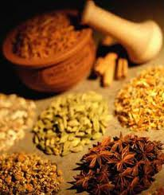
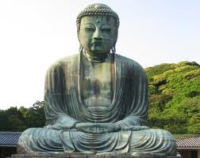
INDIA: SILK ROAD DESTINATION
MOVEMENT OF IDEAS:
BUDDHISM & HINDUISM
“ZERO”, DECIMAL SYSTEM, MODERN NUMERS, PI
SURGERY AND PLANT MEDICINES

Slide 37
SEA ROUTES
WHILE ONLY THE NORTHERN AND SOUTHERN LAND ROUTES =“TRUE SILK ROAD”, TRADE BY SEA V. IMPORTANT
SHIPS CAN CARRY MORE GOODS
CAN VISIT MORE (& MORE DISTANT) PLACES EASIER
ONLY GOOD FOR CHINA, INDIA, M.E. UNTIL ~ 1400 A.D. WHEN SEA ROUTES START TO REPLACE LAND ROUTES

Slide 38
A FEW SEA ROUTE STOPS
INDONESIA: SPICES, SPICES, TIMBER!
BURMA: AMBER & PEACOCK FEATHERS
INDIA: TIMBER EASIER TO CARRY
AFRICA: EASIER TO VISIT BY SEA: GOLD, GOLD, GOLD!; IVORY, ANIMAL SKINS, SLAVES (ONLY TRADE W/ EASTERN COAST UNTIL 1400)(SWAHILI TRADING AREA: SO IMP.= MAKE NEW LANGUAGE)

Slide 39
IMPACT OF SILK ROAD
THE SILK ROAD CHANGED WORLD IMMENSELY
LIVES WERE ENRICHED BY EXCHANGE OF :
MATERIAL GOODS AND ECONOMIC TRADE
RELIGIOUS BELIEFS
CULTURES: FOODS, CLOTHES, LANGUAGES
IDEAS AND WAYS TO DO & MAKE THINGS (SCIENCE, ART, MEDICINE, ARCHITECTURE, PHILOSOPHY, LITERATURE, LAWS, GOVT, ETC)

Slide 40
Silk Road Webquest
Complete the silk road webquest in your binder. You can use the electronic version on Google Classroom (titled Silk Road) to find links to the websites instead of typing them in.
Create a bumper sticker with table members. See examples on board.
Due Thursday Feb 4 (will not work on in class that day)

